Slide 1

Paper
Sense
AI That Grades Smarter
Presented by: Enginnovention

Slide 2

The Problem: Inefficient Grading
Excessive Time
Inconsistent Correction
The Solution
Teachers spend too much time on manual grading, reducing time for teaching and planning.
PaperSense transforms manual paper checking into intelligent auto-evaluation. AI reads, understands, and scores answers — all in seconds.
Student correction quality varies due to human factors like fatigue or mood variation.

Slide 3

PaperSense: Solution Overview
An AI-powered system that scans, reads, and evaluates handwritten answer sheets using advanced technology.
AI-Based Evaluation
OCR Integration
Core logic for intelligent scoring.
Extracts text from handwritten sheets.
Feedback Dashboard
Instant Results
Provides detailed performance analytics.
Generates scores and feedback immediately.
Cloud & Mobile
Fair & Consistent
Accessible anytime, anywhere.
Ensures bias-free, reliable grading.

Slide 4

Desirability: User Need & Impact
80%
100%
Time Saved
Bias-Free
Reduction in manual correction time.
Objective and consistent scoring.
Key Benefits
AI evaluates handwritten answers instantly.
Provides instant feedback and analytics.
“It transformed evaluation — faster, fairer, and smarter.” – Faculty Pilot
Target Users: Teachers, students, and educational institutions.

Slide 5



Feasibility & Viability
Feasibility: Can We Build It?
Viability: Is It Sustainable?
The solution is fully feasible using free, open-source tools.
Dual-impact model focusing on social good and SaaS revenue.
Tech Stack Highlights
Python, Flask/FastAPI, Streamlit
Tesseract OCR & Hugging Face NLP
Firebase/MongoDB for data
$25B+
Upload
Market Size
NLP
Global EdTech assessment market.
Dashboard
OCR
1.5B
AI Scoring
Exams/Year
Estimated handwritten exams annually.
Revenue Model
Freemium for small institutes; paid enterprise plans. Extendable to forms and surveys.

Slide 6
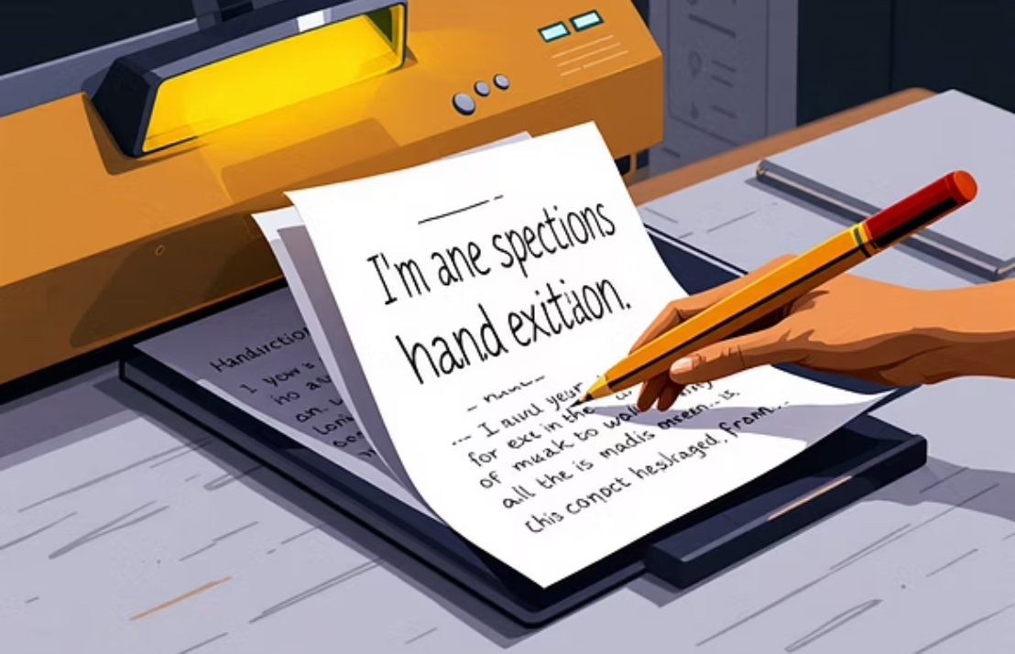


Prototype & Demo Highlights
We have a functional prototype demonstrating key interactions and real-time scoring.
Demo Link: https://markwise-3.preview.emergentagent.com/

Slide 7

Roadmap: From Prototype to Product
Built
Functional prototype completed.
Next 1 Week
Complete full application development.
Next 60 Days
Pilot program launch in schools/colleges.
Long-Term Vision
Integrate with competitive and university-level exams.

Slide 8

Meet Team Enginnovention
Sanjeevi B
Karthik B
Team Lead, Backend, Logic
Frontend, Graphics
Dinesh Kumar
DevOps, AI Scaling
Team Ethos: “Teamwork makes everything a cup of tea.”

Slide 9




Our Ask: Support for Scaling
Mentorship
Funding
Partnerships
AI model refinement
Cloud deployment costs
EdTech firms for integration
Scalable architecture design
GPU resources for OCR
Educational institutions for pilot programs
Extensive testing
We also seek feedback on ethics, fairness, and performance metrics.

Slide 10

Thank You
Smarter AI, Faster Grading, and Fairer Results
Email
LinkedIn
sanjeevimxal@gmail.com
Sanjeevi B
GitHub
Sanjeev-imxal

